Slide 1

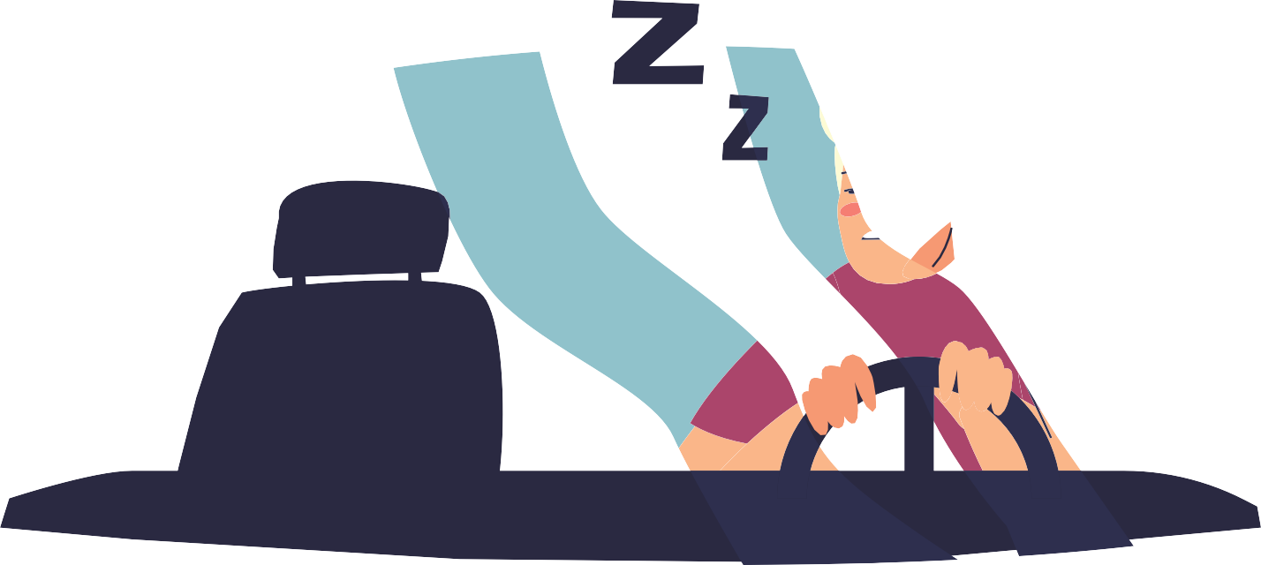

PRESENTATION TOPIC -
DRIVER'S DROWSINESSYSTEM DETECTION
Vaishnavi Nighojkar(EN20CS301487)
Vanshika Kapur(EN20CS301490)
Yash Rayate(EN20CS301512)
UNDER THE GUIDANCE OF MR. Ashish Kumawat

Slide 2







AN INTRODUCTION
Driver drowsiness detection is a car safety technology which prevents accidents when the driver is getting drowsy. Death in car accident is one of the major causes of death. There is one death every four minutes due to a road accident in India. Over 1,37,000 people were killed in road accidents in 2019 alone, that is more than the number of people killed in all our wars put together.
Studies showed almost all the accidents that happen at night is because the driver ends up getting drowsy and eventually losses control of the vehicle. It not only causes a loss of life but is also a big loss for such accidents generally are causes by truck drivers who often loss the goods/materials they carry. To prevent such accidents we propose a system which alerts the driver if the driver gets distracted or feels drowsy.
Drivers drowsiness Detection System a computer vision system that can automatically detect driver drowsiness in a real-time video stream and then play an alarm if the driver appears to be drowsy. Facial landmarks detection is used with help of image processing of images of the face captured using the camera, for detection of distraction or drowsiness. This whole system is deployed on portable hardware which can be easily installed in the car for use.

Slide 3



01. PROBLEM STATEMENT
Driver Fatigue is often caused by four main factors: sleep, work, time of day, and physical. Often people try to do much in a day and they lose precious sleep due to this.
The lack of sleep builds up over a number of days and the next thing that happens is the body finally collapses and The person falls asleep. People sometimes are on medications that create drowsiness or have physical ailments that cause these issues.
The drowsiness detection systems monitoring the driver’s condition requires complex computation and expensive equipment, not comfortable to wear during driving and is not suitable for driving conditions; for example, Electroencephalography (EEG) and Electrocardiography (ECG), i. e. detecting the brain frequency and measuring the rhythm of heart, respectively.

Slide 4

02. Objective
1
Basic concept of drowsiness detection system
This project aims to propose an accessible and simple method to detect drowsiness by using video or webcam. It analyzes the video images that have been recorded and come up with a system that can analyze each frame of the video. We aim to focus on these following procedures:
2
3
Familiarize with the signs of drowsiness
Determine the drowsiness from these parameters - Eye blink - Area of the pupils detected at eyes - Yawning
4
Integration of the methods chosen.
5
6
Coding development and testing.
Complete testing and improvement.

Slide 5
03. Previous Work
Drowsiness detection can be divided into three main categories (1) Vehicle based (2) Behavioural based
(3) Physiological based. Drowsiness detection is based on these three parameters. A detailed review on these measures will provide insight on the present systems, issues associated with them and the enhancements that need to be done to make a robust system.
01
Vehicle based measures
A number of metrics, including deviations from lane position, movement of the steering wheel, pressure on the acceleration pedal, etc., are constantly monitored and any change in these that crosses a specified threshold indicates a significantly increased probability that the driver is drowsy.
Behavioural based measures
The behavior of the driver, including yawning, eye closure, eye blinking, head pose, etc. is monitored through a camera and the driver is alerted if any of these drowsiness symptoms are detected.
03
Physiological based measures
he correlation between physiological signals ECG (Electrocardiogram) and EOG (Electrooculogram). Drowsiness is detected through pulse rate, heart beat and brain information.
02

Slide 6

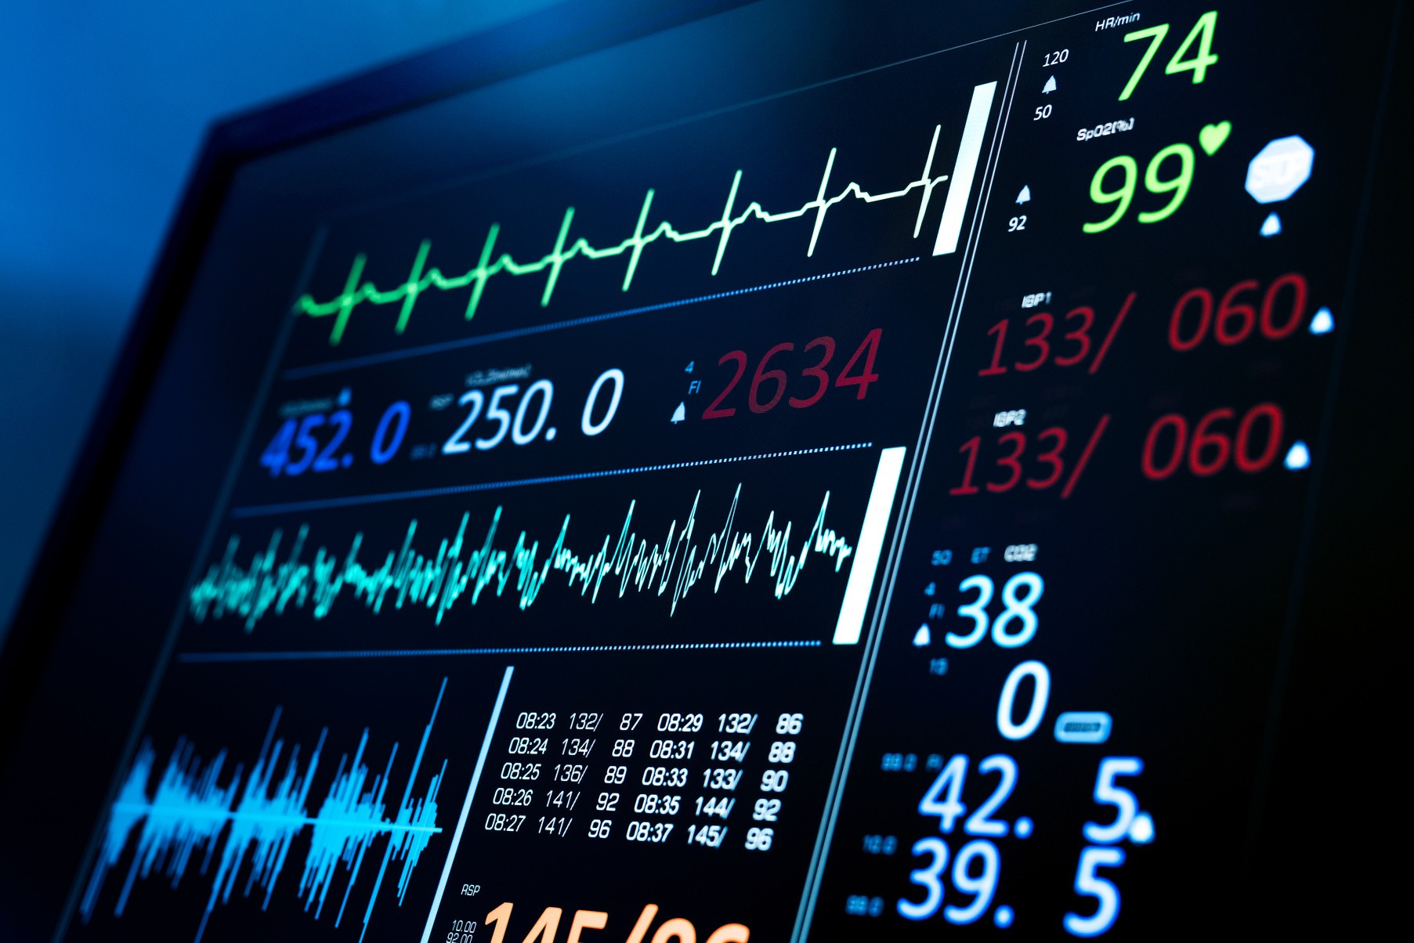
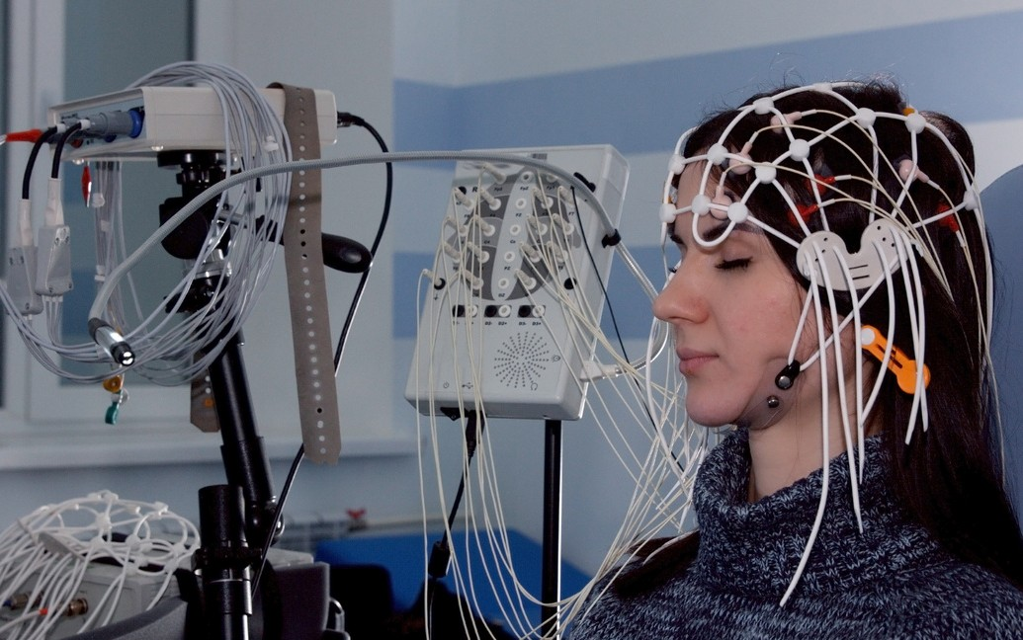
04. ECG and EEG
Many researchers have considered the following physiological signals to detect drowsiness: electrocardiogram (ECG), electroencephalogram (EEG). The heart rate (HR) also varies significantly between the different stages of drowsiness, such as alertness and fatigue. Therefore, heart rate, which can be easily determined by the ECG signal, can also be used to detect drowsiness.
Others have measured drowsiness using Heart Rate Variability (HRV), in which the low (LF) and high (HF) frequencies fall in the range of 0.04–0.15 Hz and 0.14–0.4 [12]” , shows physiological signal sensing system that can be integrated into vehicles to detect driver drowsiness.
The Electroencephalogram (EEG) is the physiological signal most commonly used to measure drowsiness. The EEG signal has various frequency bands, including the delta band (0.5–4 Hz), which corresponds to sleep activity, the theta band (4–8 Hz), which is related to drowsiness, the alpha band (8–13 Hz), which represents relaxation and creativity, and the beta band (13–25 Hz), which corresponds to alertness . A decrease in the power changes in the alpha frequency band and an increase in the theta frequency band indicates drowsiness.

Slide 7

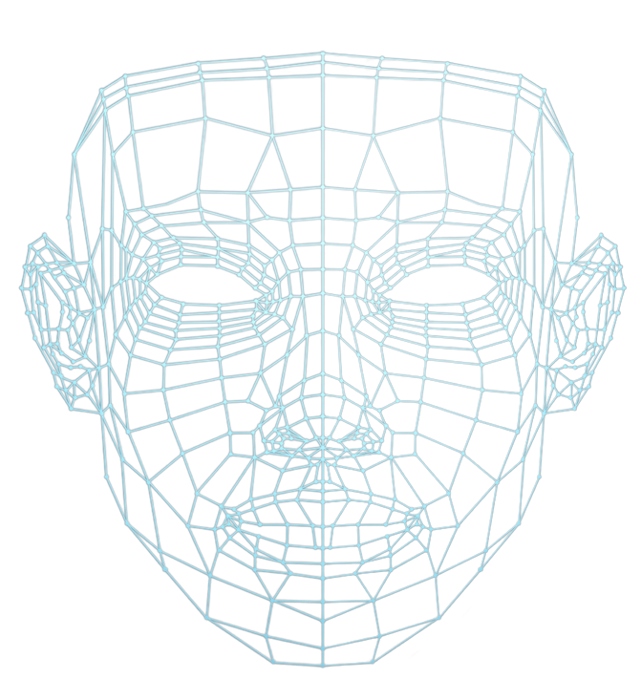
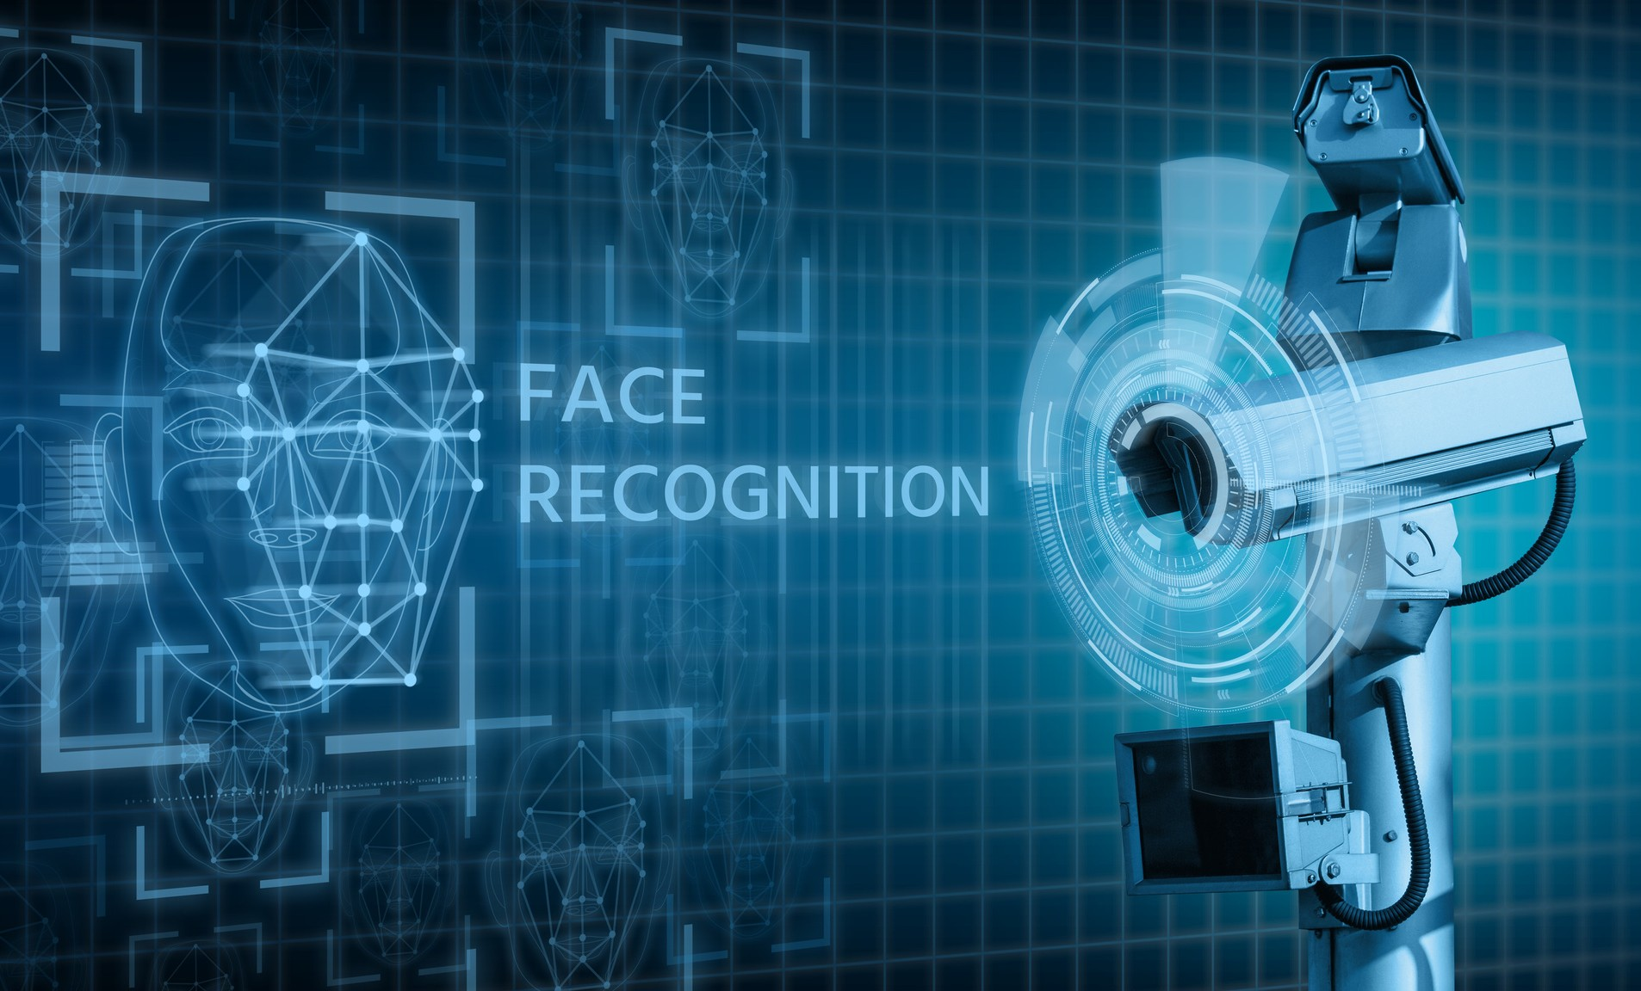
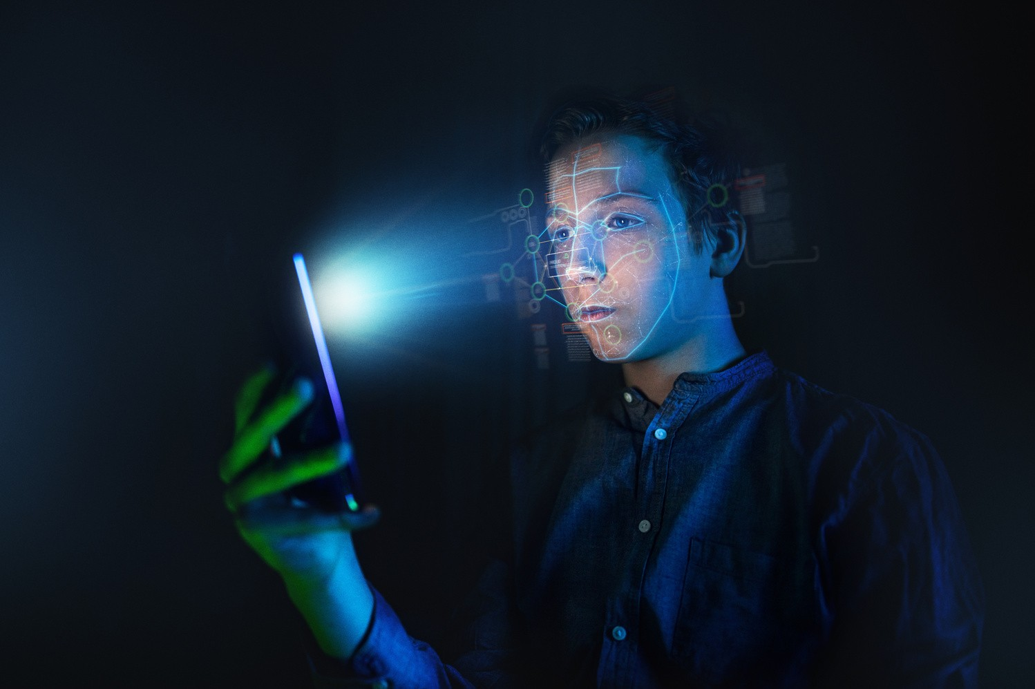
05. Proposed Method
To determine if the driver is drowsy we will find out how long a given person’s eyes have been closed for. When the driver felt sleepy at that time his/her eye blinking and gaze between eyelids are different from normal situations so they easily detect drowsiness. If there eyes have been closed for a certain amount of time , a remotely placed camera will acquire video and computer vision methods will then be applied to sequentially localize face, eyes and eyelids positions to measure ratio of closure. we’ll assume that they are starting to doze off and play an alarm to wake them up and grab their attention.

Slide 8

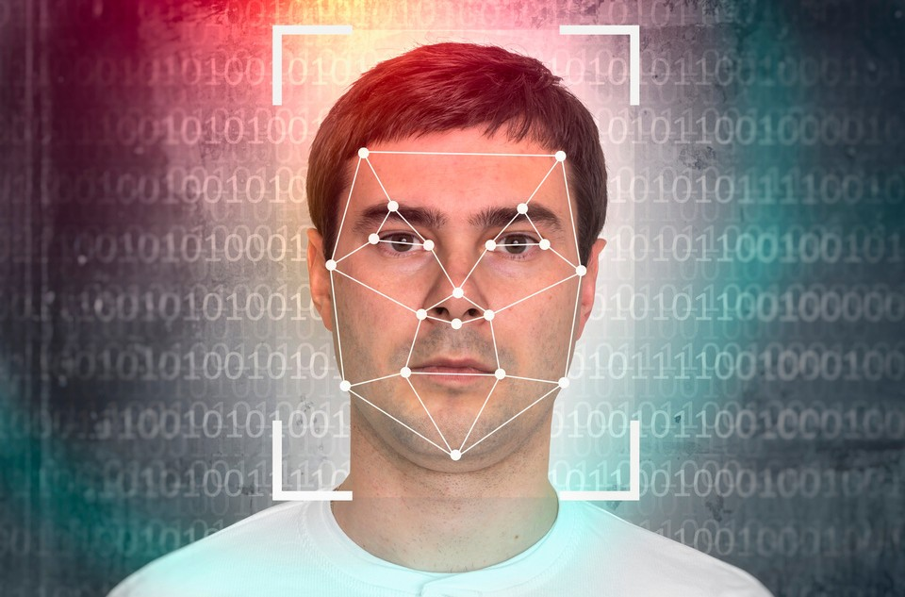


06. Scope of Proposed Method
The scope of this project is to build a system while recognizes if the driver is getting drowsy in real time. If implemented ,the Drivers Drowsiness Detection System will Detect when the driver is drowsy : With the help of real time monitoring using the drowsiness detection system we will be accurately able to figure out when the driver is getting drowsy and thus prevent road accidents from happening by alarming the driver and through this help save countless lives which are lost due to these accidents

Slide 9

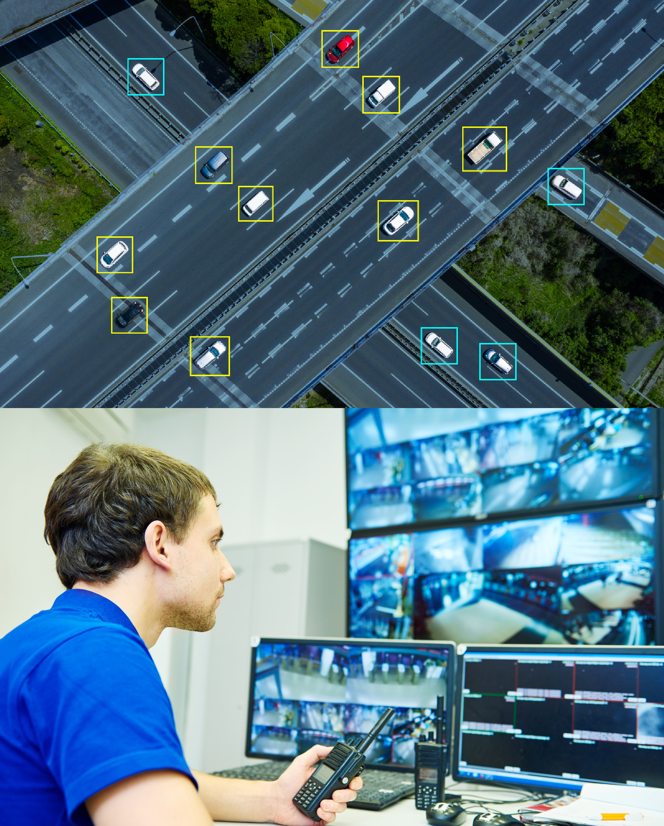
07. System Requirements
The requirements for an effective drowsy driver detection system are as follows:
01
A non-intrusive monitoring system that will not distract the driver.
02
A real-time monitoring system, to insure accuracy in detecting drowsiness.
03
A system that will work in both daytime and nighttime conditions.
The above requirements are subsequently the aims of this project. The project will consist of a concept level system that will meet all the above requirements.

Slide 10


Software Requirements Specification :
Front end :
Python 3 Libraries
Numpy
Scipy
Playsound
Dlib
Imutils
opencv, etc
Python 3
Back End:
Python
Operating System:
Windows or Ubuntu

Slide 11


08. Limitations
The limitations of the project are:
Aspects which can be worked on future are:
Dependency of hardware specially the webcam which might cause issues since the image quality directly affects the processing
01
Instead of a webcam , mobile phones camera can be used
02
03
Vechicle itself can be alarmed and stop after a certain period of time
More accuracy with higher speed can be achieved

Slide 12

Thank You

